Slide 1
Oracle SQL

Slide 2
Set Operations
Set operators are used to join the results of two (or more) SELECT statements.
The UNION set operator returns the combined results of the two SELECT statements.Essentially,it removes duplicates from the results i.e. only one row will be listed for each duplicated result.To counter this behavior,use the UNION ALL set operator which retains the duplicates in the final result.
INTERSECT lists only records that are common to both the SELECT queries; the MINUS set operator removes the second query's results from the output if they are also found in the first query's results. INTERSECT and MINUS set operations produce unduplicated results.
Minus operator displays the rows which are present in the first query but absent in the second query, with no duplicates and data arranged in ascending order by default.

Slide 3
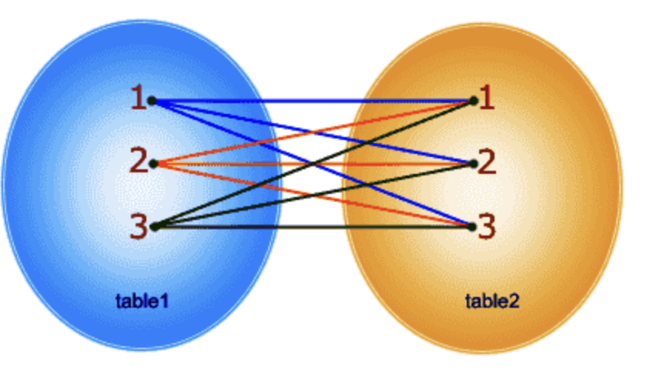
Cartesian Product
The CROSS JOIN specifies that all rows from first table join with all of the rows of second table. If there are "x" rows in table1 and "y" rows in table2 then the cross join result set have x*y rows. It normally happens when no matching join columns are specified.
SELECT * FROM emp CROSS JOIN dept ;
https://www.w3resource.com/oracle/joins/oracle-cross-join.php

Slide 4
Join
Oracle join is used to combine columns from two or more tables based on values of the related columns.
Inner Join- (An inner join includes only those tuples with matching attributes and the rest are discarded in the resulting relation)
Theta Join
Natural Join
Equi Join
Outer Join – (include all the tuples from the participating relations in the resulting relation.)
Left Outer join
Right Outer Join
Full Outer Join
https://www.oracletutorial.com/oracle-basics/oracle-joins/
https://livesql.oracle.com/apex/livesql/file/tutorial_K1PL8IWJPLMM4ZBZSX2K1LRQU.htmls

Slide 5

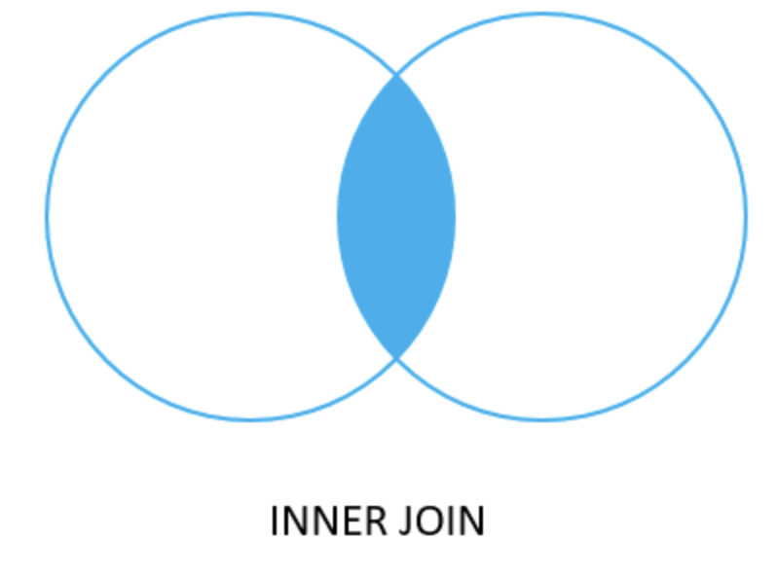
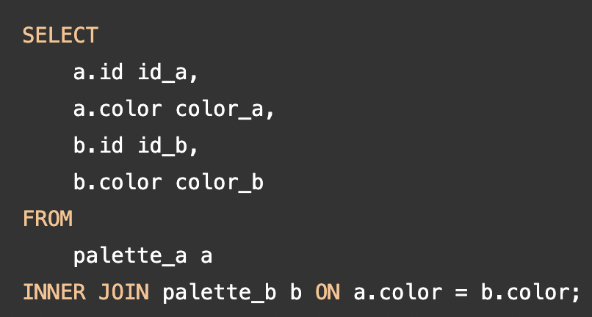
Inner Join
INNER JOIN is used to return rows from both tables which satisfy the given condition.

Slide 6
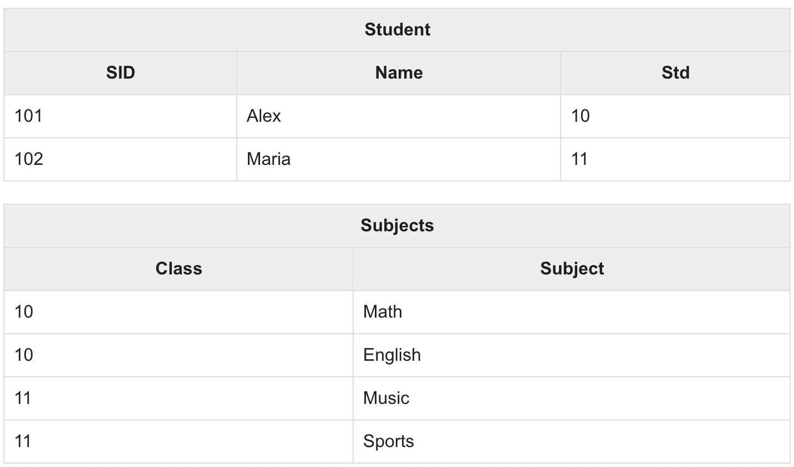
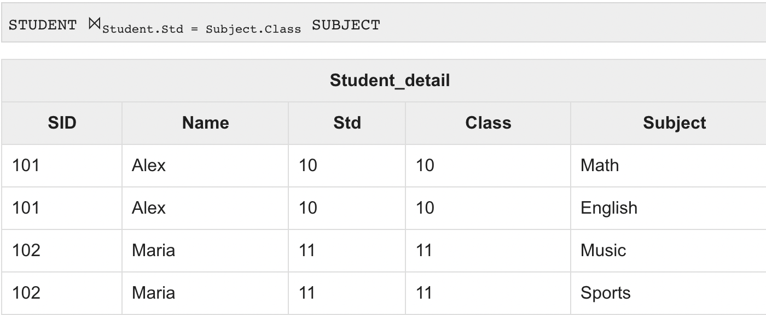
Inner Join – Theta
THETA JOIN allows you to merge two tables based on the condition represented by theta. Theta joins work for all comparison operators. It is denoted by symbol θ.

Slide 7
Inner Join – Equi Join
When Theta join uses only equality comparison operator, it is said to be equijoin.
The above example corresponds to equijoin.

Slide 8
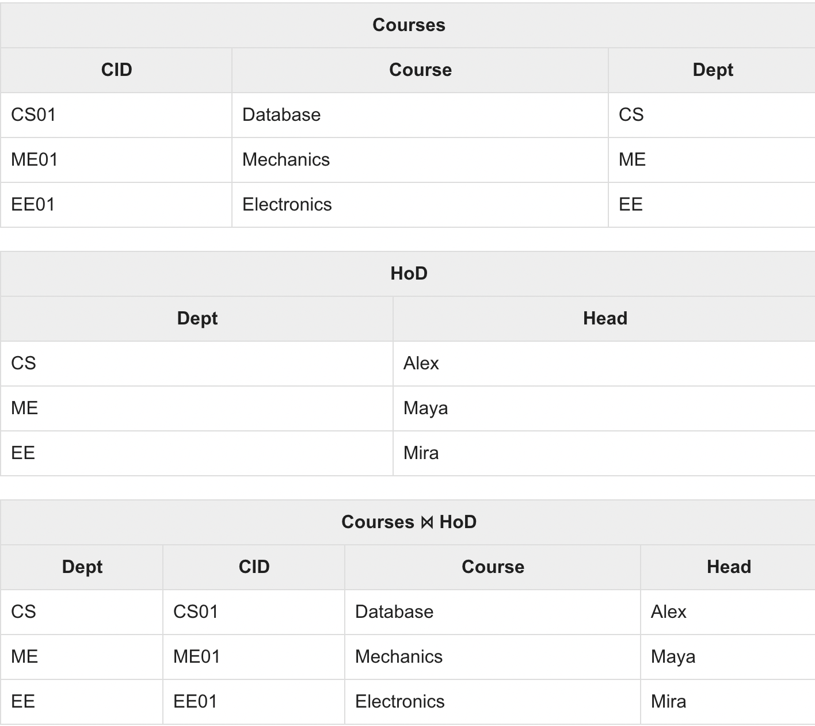
Natural Join
Natural join does not use any comparison operator. It does not concatenate the way a Cartesian product does. We can perform a Natural Join only if there is at least one common attribute that exists between two relations.
SELECT * FROM Course NATURAL JOIN HOD

Slide 9
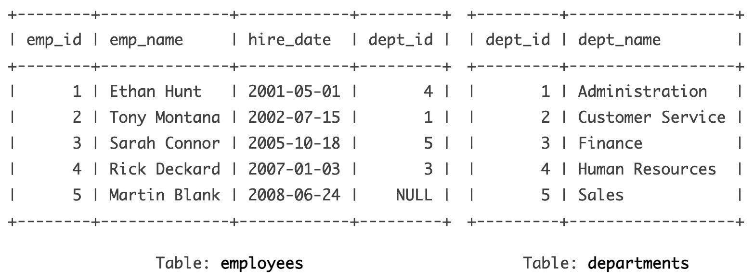
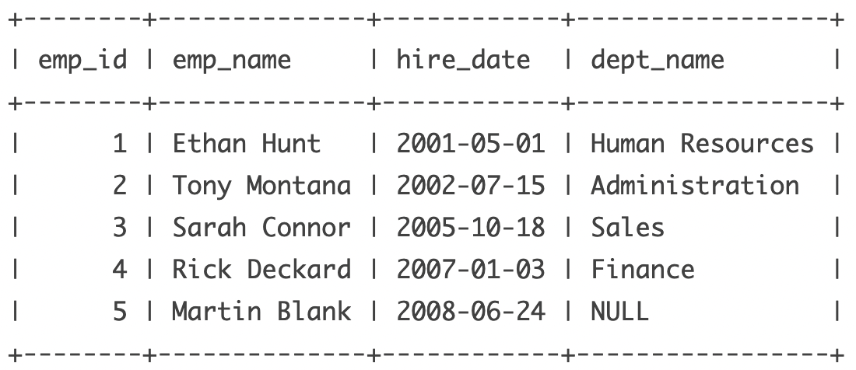
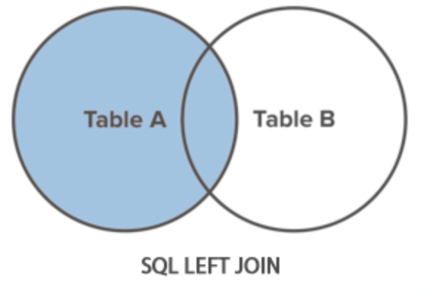
Left Join
A LEFT JOIN statement returns all rows from the left table along with the rows from the right table for which the join condition is met.

Slide 10
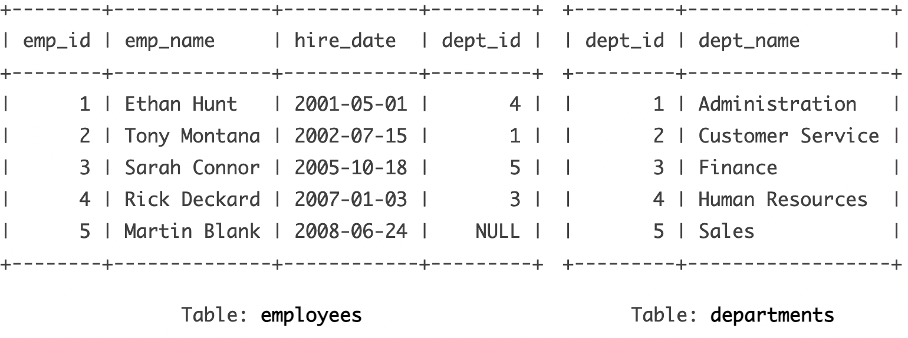
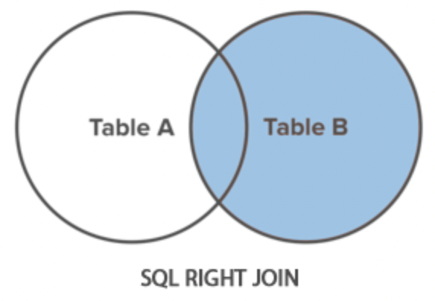
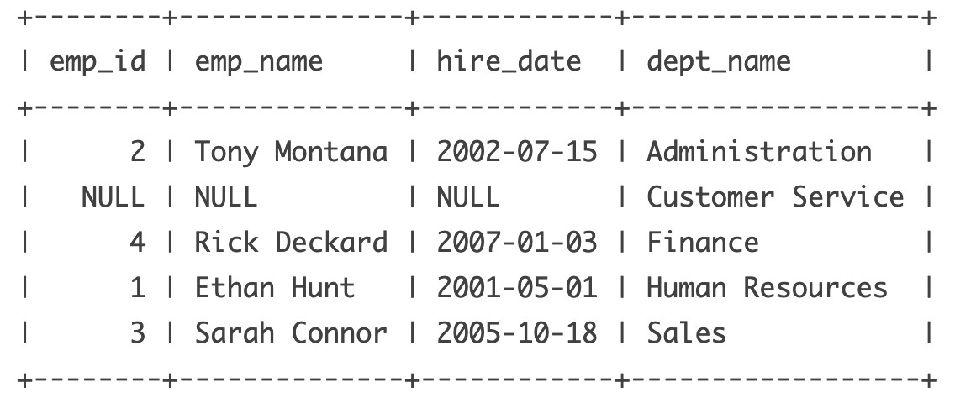
Right Join
It returns all rows from the right table along with the rows from the left table for which the join condition is met.

Slide 11

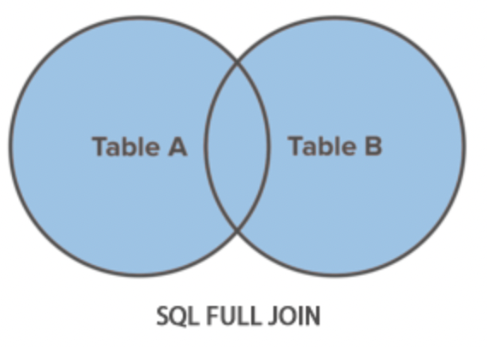
Full Outer Join
A FULL JOIN returns all the rows from the joined tables, whether they are matched or not

Slide 12
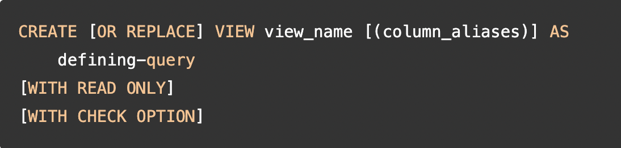
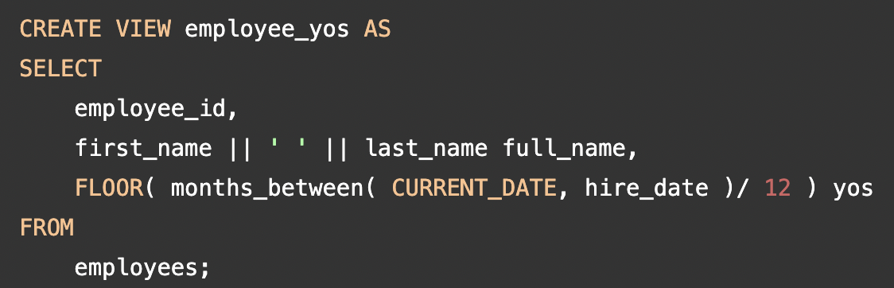
Views
Logical table based on one or more tables or views.
A view contains no data itself. The tables upon which a view is based are called base tables.
The WITH READ ONLY clause prevents the underlying tables from changes through the view.
The WITH CHECK OPTION clause protects the view from any changes to the underlying table that would produce rows which are not included in the defining query.
https://livesql.oracle.com/apex/livesql/s/k3n2uojej6xf66q2eenlcylua

Slide 13
Index
Index are database object which can be created on Table.
https://livesql.oracle.com/apex/livesql/docs/admin/managing-indexes/create.html

Slide 14
Index Advantage
Speed up SELECT queries and reports
Reduce I/O and Lowest I/O
Fast Data Access
Prevent duplication (primary,unique)

Slide 15
Disadvantage of INdex
Since Indexes physically take up space on the Disk, using the Index will increase the extra disk cost unless necessary.
In general, indexes improve performance in our Select queries and slow down DML (insert, update, delete) operations. Especially in tables where too many DML operations are performed, index should not be used.
When we use index, database has an extra load because the maintenance (index maintenance) load of the database will increase.

Slide 16
Types Of Index
B Tree Index
Bitmap Index
Function Based Index
Unique Index

Slide 17
When to use BITMAP ?
Table column with low cardinality level
Very Less DML activity, Preferably read activity

Slide 18
Functional INdex
A function-based index calculates the result of a function that involves one or more columns and stores that result in the index.
https://www.oracletutorial.com/oracle-index/oracle-function-based-index/

Slide 19
Delete Vs Drop Vs Truncate
The DELETE command is used to remove some or all rows from a table. A WHERE clause can be used to only remove some rows
DELETE FROM emp WHERE job = 'CLERK';
TRUNCATE removes all rows from a table. The operation cannot be rolled back
TRUNCATE TABLE emp;
The DROP command removes a table from the database. All the tables' rows, indexes and privileges will also be removed.
DROP TABLE emp;
Note: DROP and TRUNCATE are DDL commands, whereas DELETE is a DML command. Therefore DELETE operations can be rolled back (undone), while DROP and TRUNCATE operations cannot be rolled back.
https://tipsfororacle.blogspot.com/2016/09/delete-vs-truncate-vs-drop.html

